Slide 1



LOGO
Emil Persson
Head of Research
Joel de Vahl
Engine Programmer

Slide 2

Populating a Massive Game World
Notes:
In this talk we will cover two different aspects of populating a massive game world: 1) The production of content and the tools pipeline. 2) Bringing it to life and rendering.
We will try to give some insight into some of the problems we ran into developing and delivering a large world with content, as well as how we solved them.

Slide 3
Introduction
Avalanche makes big games!
Just Cause 1 - 32km x 32km
Just Cause 2 - 32km x 32km
Same size, but JC2 >> JC1
More content
World well populated
Focus on areas outside of key missions
Designed for replayability
More "life"
Notes:
Large open-world games is the specialty of Avalanche Studios. Both Just Cause games are over 1,000 km2, or 400mi2.
Just Cause 1 - Released in 2006. Generally perceived as rather empty.
Just Cause 2 - Released in 2010. Generally perceived as endless supply of stuff to blow up.
Same size, JC2 felt "bigger" - More content. Hundreds of thousands of players keep playing JC2 several years after release. Hardly the case for JC1.

Slide 4
Retrospect
Just Cause 2 was great
... but
Our tools sucked
Our pipeline had grown organically
Lots of down-time and horrible turnaround times
Fortunately:
We have come a long way since then
Notes:
While we ultimately reached our goals and shipped a high-quality game, getting there was not all a success story. It is also a story about poor tools, broken builds, horrible turnaround times, and the efforts to salvage the situation. Looking back given the state we are in now, and how things looked back then, it is amazing and a true feat of the team to be able to ship Just Cause 2, especially at the quality level we reached in the end. Needless to say, the quality of our tools was nowhere near the same as the game.

Slide 5
Bringing it to life
World simulation
Diverse game and climate zones
Jungle, arctic, desert, sky zone etc.
Unlimited draw distance
Landmarks
Distant lights
Verticality

Slide 6
World Simulation
There is always something going on
Civilians
Vehicles
Animals
Also important to gameplay
Dynamic weather system
Day-night cycle
Variable time speed
Notes:
To make the world living, we have a world simulation system that makes sure there is always something going on. It spawns civilians, vehicles, airplanes and boats around the player.
Not only is this important to make the world living, it's also important to gameplay since it ensures that the player can always get out of a tight spot. For example if the player crashes a plane at sea we can make sure a boat passes at a reasonable distance quite soon.
The system also makes sure there is a bit of animal life, such as birds, insects, fish and scorpions. Similarly, there’s also typically a leaf or two falling from the trees here and there. These small details really make a big difference for making the world come to life.
Worth mentioning here is also our day night cycle. As we found out during development, players prefer daytime more than night time, so our system has a non-linear time flow. We have a longer day, and a shorter night. We also highlight sunset and rise by staying longer there.

Slide 7
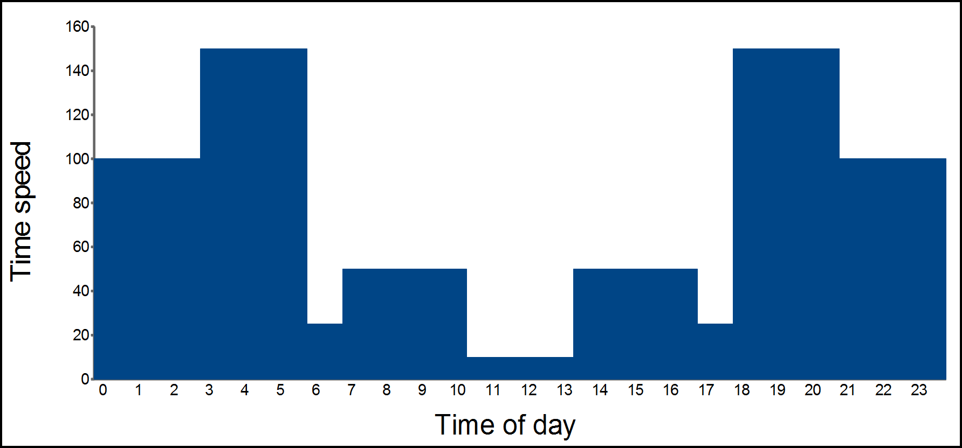
Time of day cycle
Notes:
Time moves fast during night, especially just before sunrise and after sunset. Sunrise and sunset is visually pleasing though, so we stay longer at those hours, then fast-forward a little after sunrise to mid-day, stay there for a quite long time, then fast-forward to sunset.

Slide 8
Vegetation Rendering
Four systems for rendering
Full models with LOD
Impostors
Forest carpet
Forest fins
Notes:
The vegetation is rendered in 4 different ways, depending of distance.
1) At the closest distance we have full models, complete with the regular LOD setup. These are also animated, swaying in the wind and such.
2) Further back we have simple view-aligned impostors.
3) Even further away we replace the impostors with a "forest carpet" mesh rendered above the terrain.
4) We also add "forest fins" at a distance to give far mountains a good silhouette.

Slide 9
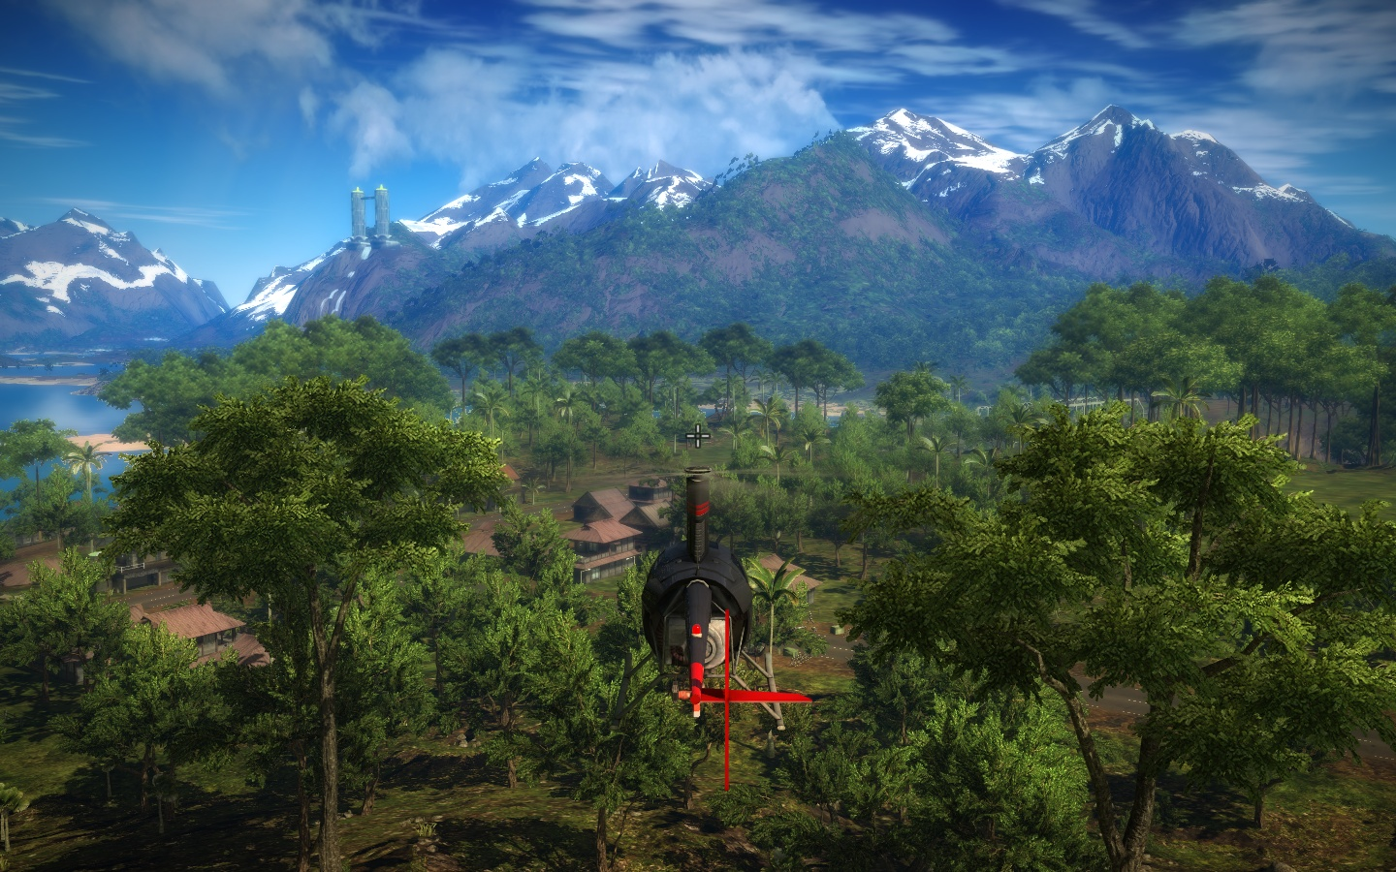
Vegetation Rendering
Notes:
The vegetation is rendered in 4 different ways, depending of distance.
1) At the closest distance we have full models, complete with the regular LOD setup. These are also animated, swaying in the wind and such.
2) Further back we have simple view-aligned impostors.
3) Even further away we replace the impostors with a "forest carpet" mesh rendered above the terrain.
4) We also add "forest fins" at a distance to give far mountains a good silhouette.

Slide 10
Vegetation Rendering
Notes:
The vegetation is rendered in 4 different ways, depending of distance.
1) At the closest distance we have full models, complete with the regular LOD setup. These are also animated, swaying in the wind and such.
2) Further back we have simple view-aligned impostors.
3) Even further away we replace the impostors with a "forest carpet" mesh rendered above the terrain.
4) We also add "forest fins" at a distance to give far mountains a good silhouette.

Slide 11
Landmarks
Large draw distance
All of the world visible from anywhere
Only near locations streamed in
Replace whole location with one model
Important to show far landmarks

Slide 12
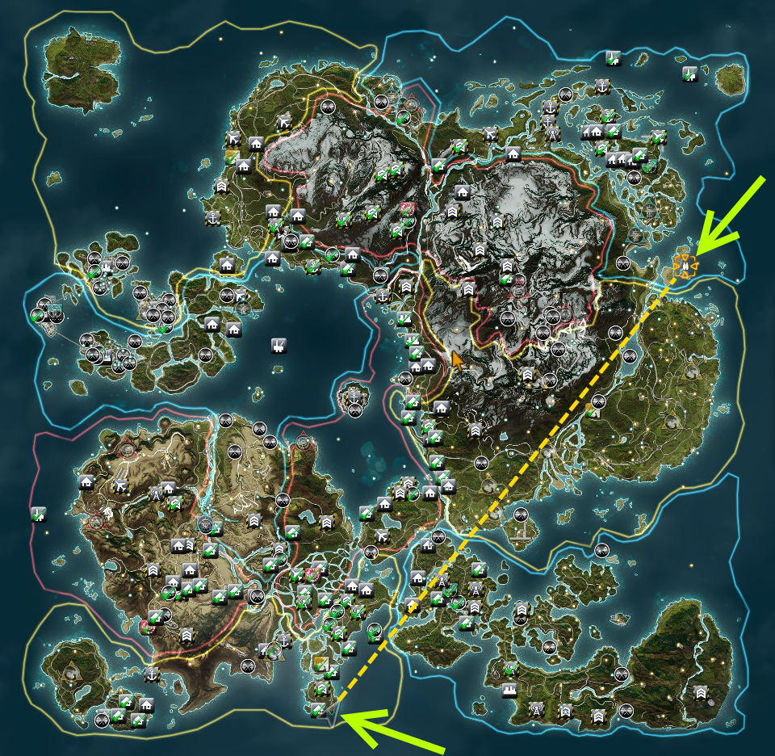
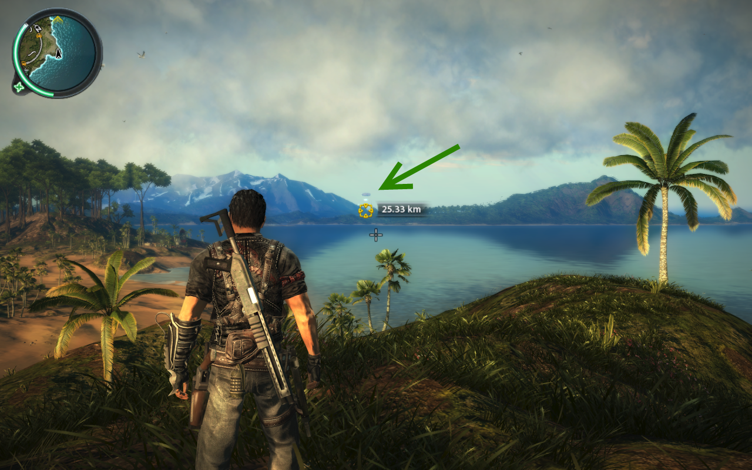
Landmarks
Notes:
Mile high club

Slide 13
Lighting
Just Cause 2 used Tiled light indexing
Described in detail in GPU Pro
Later switched to Deferred Lighting
Currently Clustered Deferred Lighting
Refer to Advances in Real-Time Rendering course
Far lights visualized with point sprites

Slide 14
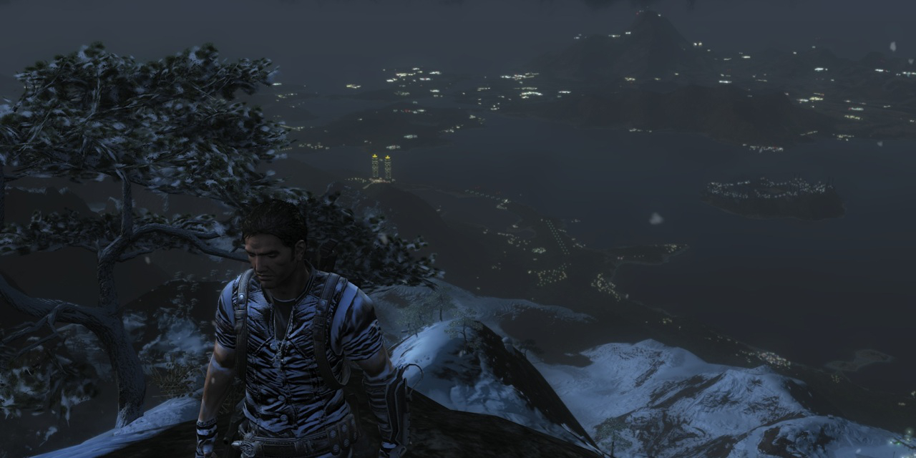
Distant lights

Slide 15
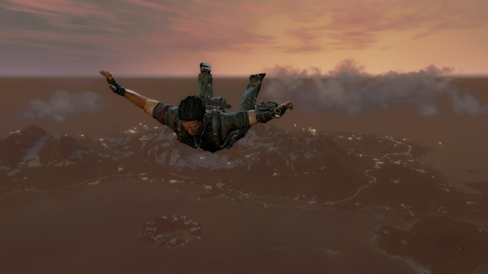
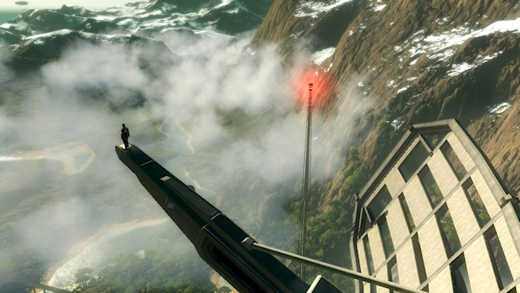
Verticality

Slide 16
Content Modularization
Reusable modules
Multiple instances
Updated module -> updated instance
Procedural placement
Notes:
One of the problems with a big world as JC2:s is that it has to be filled with meaningful things for the player to do.
We try to solve this by having reusable modules, "locations", that can be edited separately and then instanced into the world. Each instance can then be partly overridden to make that instance unique.
If a designer modifies a location template then all instances will be updated (unless overridden). This allows us to, for example, add new occluders to many instances, once the template has a final layout.
We also support procedural placement of a lot of things. We will talk a bit about vegetation later, but we also place things along roads procedurally, so that designers just can change the road splines without having to worry about lamp posts and guard rails.

Slide 17
Landscape Authoring
512x512m patches (Stream Patch)
All data required for patch
Stored separately
Edited using in house editor
Mesh procedurally generated
Notes:
Our landscape is a height field split up into 512x512 m patches that we call Stream Patches. When compiled a stream patch contains all data required for the game, not just vertex data, but texture, physics, vegetation, and materials.
Each stream patch is stored separately on disc, so artists can work in parallel on differents parts of the world.
The patches are edited in our inhouse editor but we can export import parts of the map to run through external tools such as erosion filters.
The base resolution of the terrain is one sample every 4 meters but we add more detail procedurally at runtime. This is described in more detail in our CTO Linus Blombergs recent article at gamasutra.

Slide 18
Vegetation Authoring
Procedural with artist control
Artist sets up properties
System places vegetation
Allows for placing single trees
Notes:
Our vegetation system is a procedural system that the artist can feed data into or override. It will place vegetation in an area in a deterministic way, depending on a set of weights and properties.
The artists sets up a set of properties and densities for different vegetation type (trees, brush, grass) and the system will take terrain properties such as slope, height and climate zone to place vegetation.
The artists can also override the system, removing vegetation completely from an area. We also allow for placing single trees just like any game object.

Slide 19
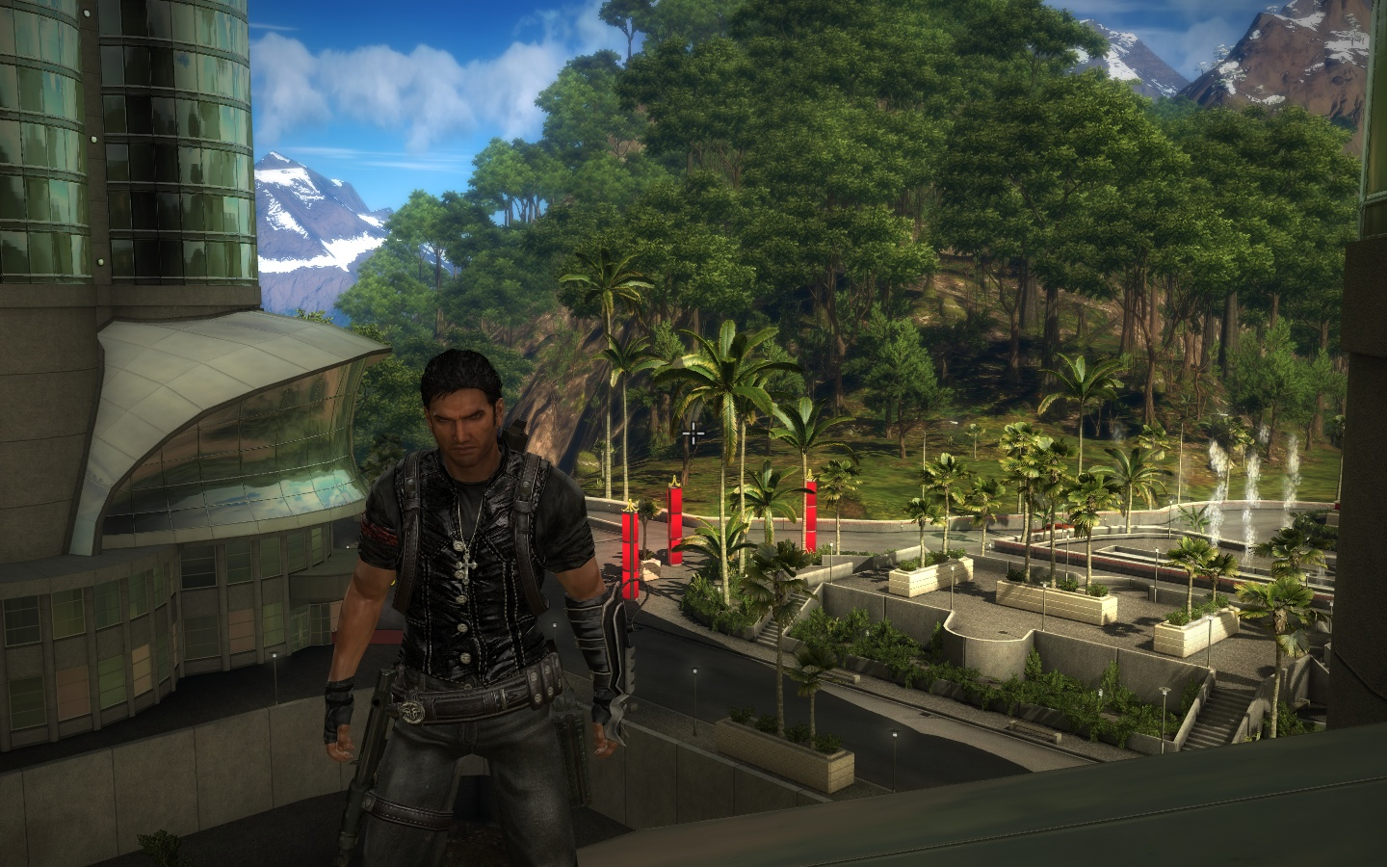
Vegetation Authoring
Notes:
Here

Slide 20
Vegetation Authoring
Notes:
Here the blue circle marks regular procedurally placed vegetation.
The green circle shows manually placed vegetation.
Being able to manually place vegetation is very important for authoring man-made areas like these. While these trees are manually placed, they are still vegetation managed by the vegetation system, rather than just being regular models. This way they behave consistently with other vegetation, become impostors in the distance, and are batched with other vegetation.

Slide 21
Content build problems
Organically grown build system
No clear dependencies
Frequently broken builds
World export from editor
Bad hot reload support
Long turnaround times
Notes:
The Avalanche content pipeline had grown organically since the start of the company and was very ad hoc. It was just a collection of compilers without very good dependency checking.
Some compilers even depended on other compiled data, from other platforms. This led to a situation where clean builds would fail, and seemingly successful builds would fail on launch since not all data was updated.
There was also a World export build step which was run from the actual editor and took 40 hours (split on 4 computers, so 10h) which would often fail due to an unstable editor. This combined with bad support for hot reloading (only textures) would lead to huge turnaround times, where an updated model wouldn't show up after days of failed builds.

Slide 22
Content build fixes
Build system
Compiler framework
Dependency walker
Compiler optimizations
Better logging/messages
In game bug display
Notes:
During JC2 completion the engine team took a holistic approach and rewrote a lot of the content build. A compiler framework and dependency walker was created and a lot of compilers was rewritten.
This resulted in a lot of speedups, for example the old model compiler was written in C++, but the new python version was about 10 times faster.
We also added a nightly unit test that made sure that incremental and full builds where identical.
Another thing that has been added since is that we try to fail as early as possible, of course this was impossible to add during production since there was a lot of broken content (due to bad or no error messages). It was eased in and now artists can hopefully fix broken content before checking in, as long as there are good error messages from the compilers.
During the end of JC2 it was mandatory to enter a world location for all bugs, so that the game could query TTP and show the bugs in game and editor. This allowed designers to clear lots of bugs in a single area quickly.

Slide 23
Content build times
Before
45 minutes data
45 minutes nav meshes
40 hours world export (4 x 10 hours)
After
12 minutes data
8 minutes nav meshes
15 minutes location compile
Notes:
All in all this resulted in a much faster pipeline:
Old: 45m data, 45m nav meshes, 40h world export
New: 12m data, 8m nav meshes, 15m location compile
The location compiler replaces the old world export step, and is run as a compile step instead of from the editor.

Slide 24
Build distribution
Batch files to get latest
Switched to Slug
Copy essentials
Stream the rest
Notes:
During JC2 we used batch files to fetch builds to local drive/devkit, but since the build was unreliable people had to keep a "latest known good" build around if the build the batch file fetched was failing.
We have now switched to an internal tool called "Slug" that allows the user to select a build (by number and branch) and start that. This together with a new VFS allows us to only copy the essential files (if any) and stream the rest directly from the content servers.

Slide 25
Conclusions
More meaningful content
World perceived as larger
Reduce build times
Faster iterations, better content
Trust the build
Fail as early as possible
Requires good error messages
Notes:
So a conclusion of the things we learned from this:
A world filled with meaningful content makes the world perceived as larger.
Reduced build times makes us all more productive due to faster iterations, and leads to better content.
It’s also important for everyone to trust the build, to actually be able to iterate fast.
And also, try to avoid accepting bad content. Reject it early with good error messages so that artists can fix it before anyone else sees it.

Slide 26


Questions?
@_Humus_
emil.persson@avalanchestudios.se
@joeldevahl
joel.de.vahl@avalanchestudios.se

Slide 27
Bonus slides

Slide 28
Code build
Primarily C++
Long compile and link times
Custom batching build step
Used to use VS build system and Incredibuild
Transitioned to JAM/WAF and build servers
Used to be one monolithic code base
Core split up into separate libs
Notes:
While is is not specific to large worlds it might be of interest here too.
Our code base is primarily C++ and we had a lot of problems with long compile and link times.
We introduced a custom batching build step that batched nearby C++ files together reducing the number of translation units. This reduced both compile and link times a lot. It also have a few side effects: on the positive side a lot more functions could be inlined by the compiler without having to use LTCG, but on the negative side there was a lot of problems with include and namespace leaks between files.
We also transitioned from VS and Incredibuild to JAM and using our own powerful remote build servers, which reduced compile times a lot.
Since then a lot of code has been broken out of the game build and put into separate precompiled libraries that are versioned and shared between projects, to reduce merge problems and increase stability and code quality.

